Slide 1


Infosys spring board Internship 6.0
Neuro-Adaptive Route Planning for Emergency Vehicles
presented By:
Yamuna D

Slide 2

1. Introduction
Emergency response vehicles often face heavy delays due to congestion. Manual traffic coordination reduces efficiency and delays rescue operations. Lack of intelligent route prioritization affects response time and public safety. Our system introduces an AI-powered adaptive routing solution for emergency mobility.

Slide 3

2. Problem Statement
Emergency vehicles (ambulances, fire trucks, police) are frequently delayed due to traffic congestion, lack of coordination, and unaware drivers, which can lead to critical loss of time and life.

Slide 4

3. Proposed Solution
An AI-based neuro-adaptive system that dynamically optimizes routes.
Controls traffic signals to create a green corridor in real time.
Uses V2V and V2I communication for alerting nearby vehicles.
Predicts and clears congestion ahead of the emergency vehicle.

Slide 5

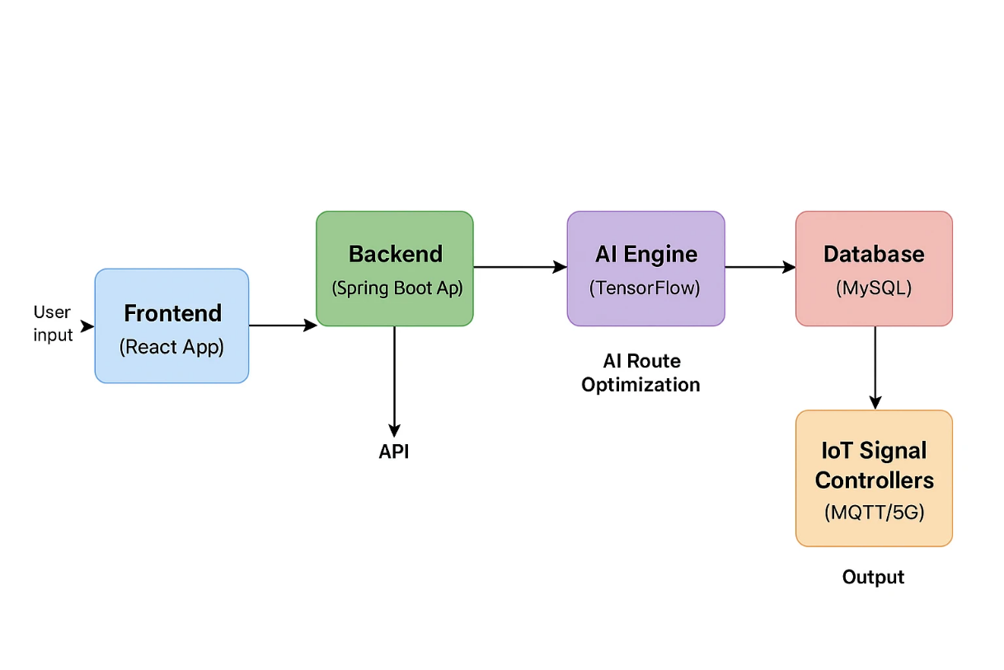
4. System Architecture

Slide 6
5. Technology Stack
Layer | Technology Used
Frontend | React, HTML, CSS
Backend | Java Spring Boot
AI Engine | TensorFlow / PyTorch
Database | MySQL
Maps | Google Maps API / Mapbox
Communication | MQTT, V2X Simulation
Deployment | Cloud / Edge AI

Slide 7

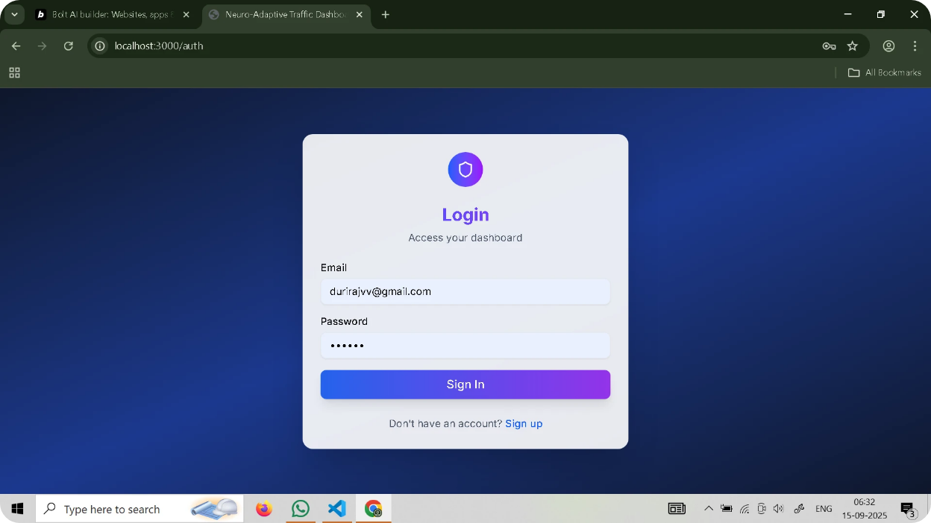
6. Module 1: Login & Signup
Provides secure access for users with role-based authentication. Built using React forms connected to Spring Boot APIs.
Ensures encrypted credentials and smooth navigation. Redirects each user to their respective dashboard.

Slide 8
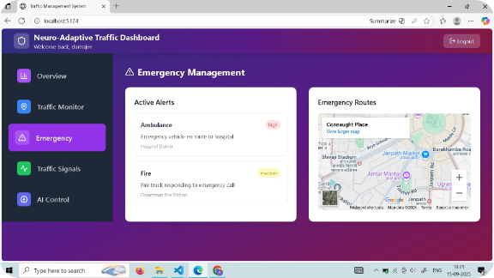
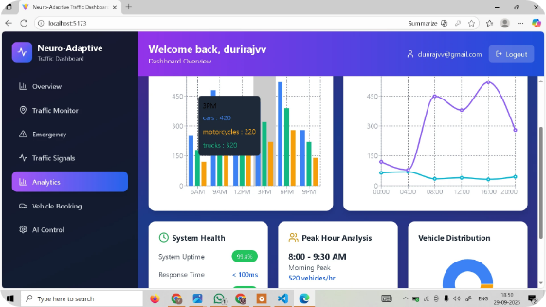
7. Module 2: Emergency & Traffic Management with Analytics
Manages live emergency routes and dynamic traffic signal control. AI engine creates real-time green corridors for faster passage.
Traffic dashboard displays live congestion and route analytics. Helps city admins monitor and optimize emergency movement.
.

Slide 9
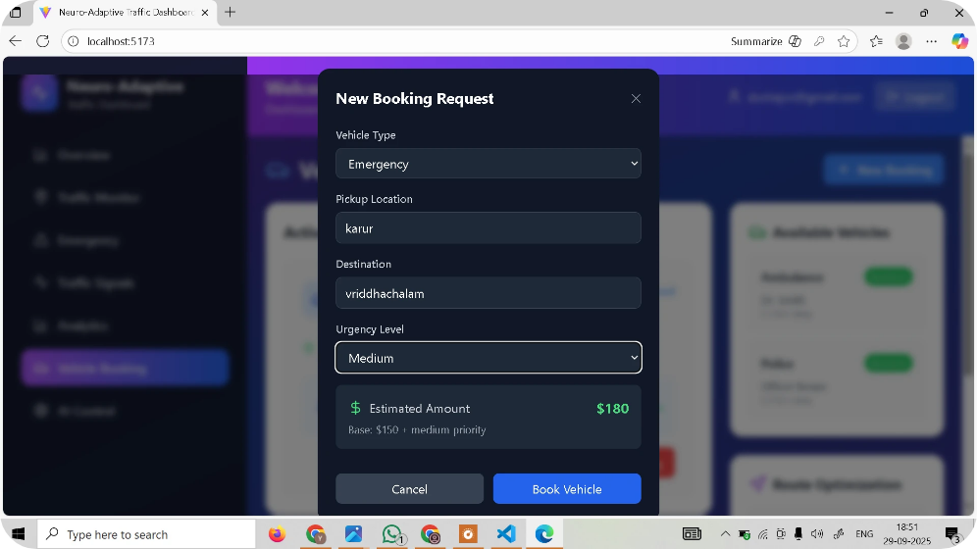
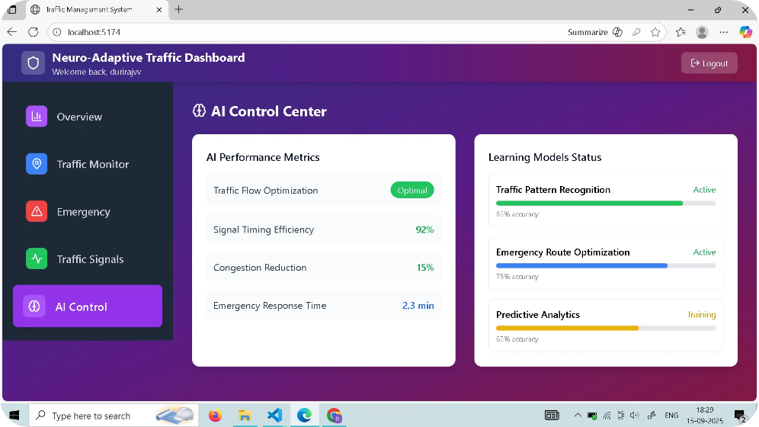
8. Module 3: Customer Booking & AI Route Optimization
Allows users to book emergency vehicles or request quick assistance.
AI model predicts traffic and selects the fastest safe route. Integrates Google Maps for real-time navigation and rerouting. Improves emergency response time using neuro-adaptive routing

Slide 10

9. Module 4: User Profile & Digital Twin Simulation
Displays user details, route history, and performance stats. Simulates real-time city traffic using digital twin environment.
Visualizes AI-driven route planning and traffic behavior.
Provides realistic testing before real-world deployment.

Slide 11
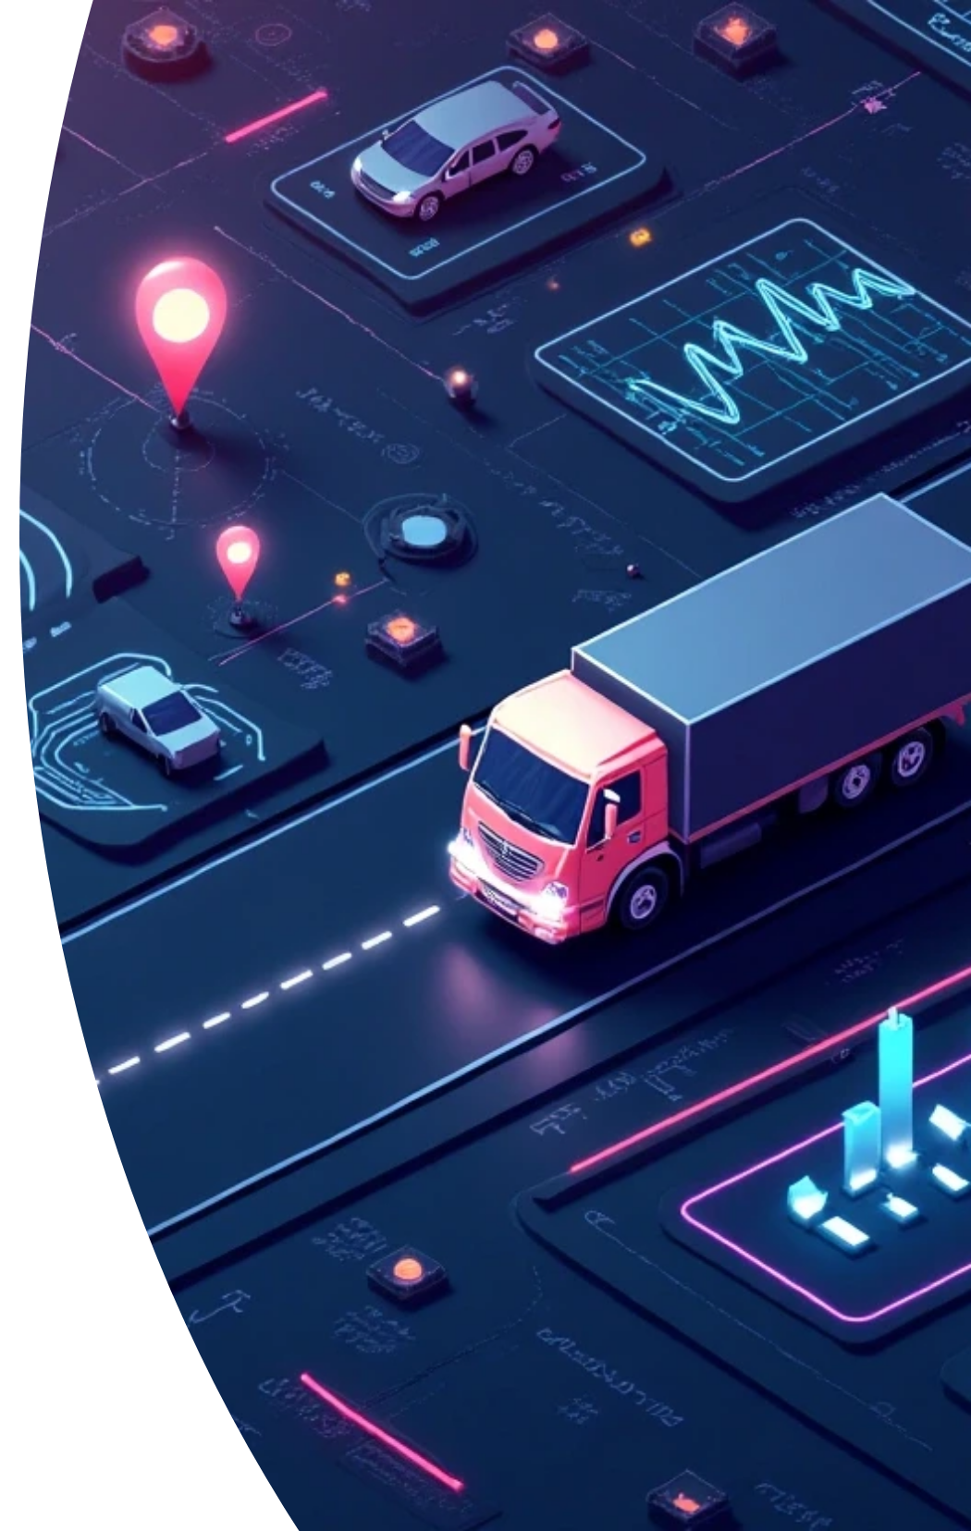
10. Results & Expected Outcomes
AI engine successfully predicts shortest congestion-free routes.
Dynamic signal control reduces emergency response time by ~40%.
Enhanced visibility for city administrators through analytics. Forms the foundation for Smart City Emergency Management.

Slide 12
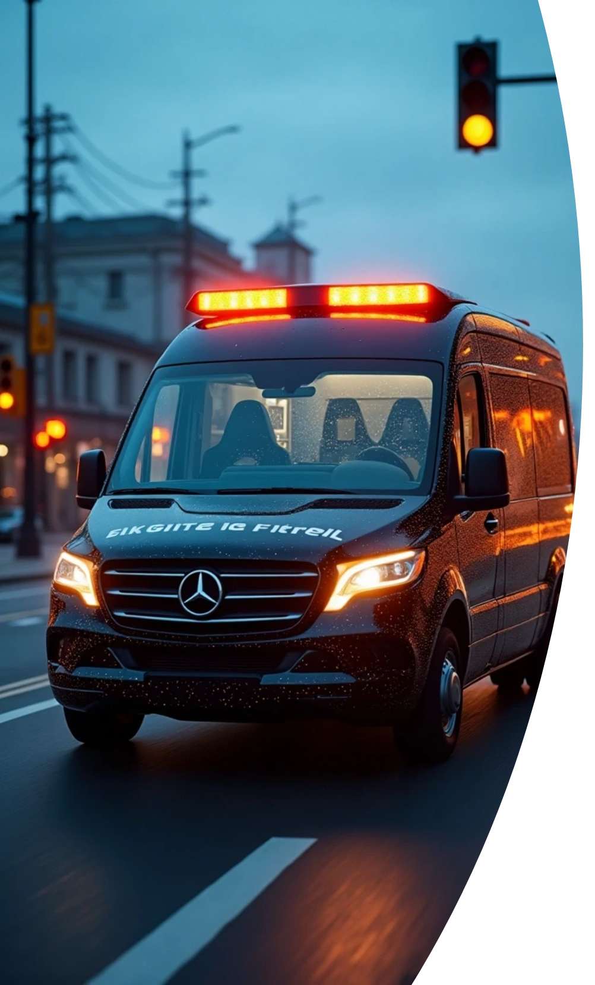


11. Conclusion & Future Enhancements
Conclusion: Developed a functional AI-driven prototype that integrates routing, IoT, and analytics for emergency vehicles.
Future Enhancements:
1
Integrate real-time 5G V2V communication.
2
Implement in partnership with municipal traffic systems.
3
Expand AI model for multi-vehicle coordination and disaster management.

Slide 13

Thank You

